Slide 1
Numerical Analysis
Seminar Session 3
Russell Kabir, PhD

Slide 2

Contents
Probabilities and P-value
Test questions
Questions and Answers

Slide 3
Session to be recorded
Please turn on microphone to talk or type in the chat box.
If not talking, please keep microphone on mute.
There will be opportunity for questions at the end too.

Slide 4
Probability
Probability measures the chance that something will happen.
There is an element of uncertainty is associated with every conclusion because information on all happenings is not available.
This uncertainty is numerically expressed as probability and expressed as the symbol ‘p’.
In statistical analysis, we are interested in probability (p) of the observed difference in two samples due to chance ( i.e, due to sampling variation).

Slide 5
Probability
In statistics, we need to find out p-value and draw inference.
If the p-value is greater than 0.05 , it is customary to accept that the difference to be due to chance (sampling variation)
The observed difference in the samples under this condition is said to be statistically not significant or insignificant.
If the p-value is less or equal to 0.05, the observed difference is considered as not due to sampling variation but due to some difference in the sample themselves.
The observed difference under these conditions, is said to be statistically significant.

Slide 6
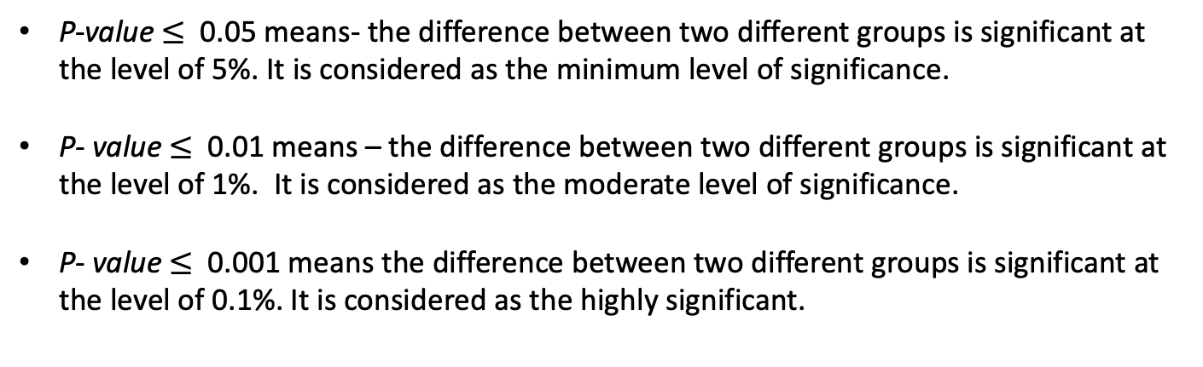
P-value
The p-value proves or disproves the null hypothesis based on its significance.
P-value $≤$ 0.05 means- the difference between two different groups is significant at the level of 5%. It is considered as the minimum level of significance.
P- value $≤$ 0.01 means – the difference between two different groups is significant at the level of 1%. It is considered as the moderate level of significance.
P- value $≤$ 0.001 means the difference between two different groups is significant at the level of 0.1%. It is considered as the highly significant.

Slide 7
P-value
P values are expressed as decimals although it may be easier to understand what they are if you convert them to a percentage.
For example, a p value of 0.0254 is 2.54%. This means there is a 2.54% chance your results could be random (i.e. happened by chance). That’s pretty tiny.
On the other hand, a large p-value of 0.9(90%) means your results have a 90% probability of being completely random and not due to anything in your experiment.
Therefore, the smaller the p-value, the more important (“significant“) your results.

Slide 8
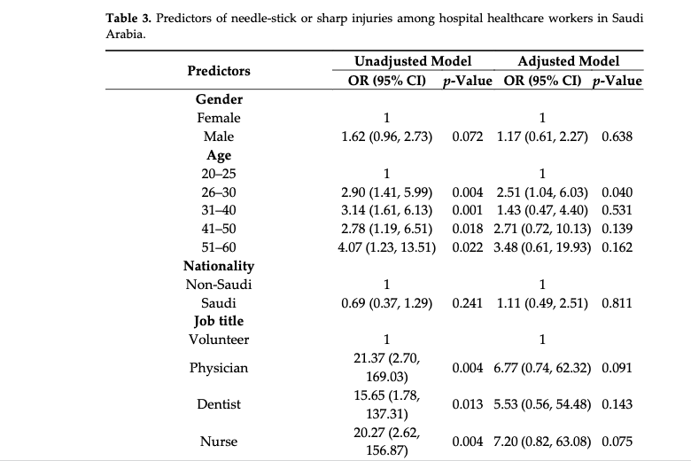
Notes:
0.56- 0.77

Slide 9
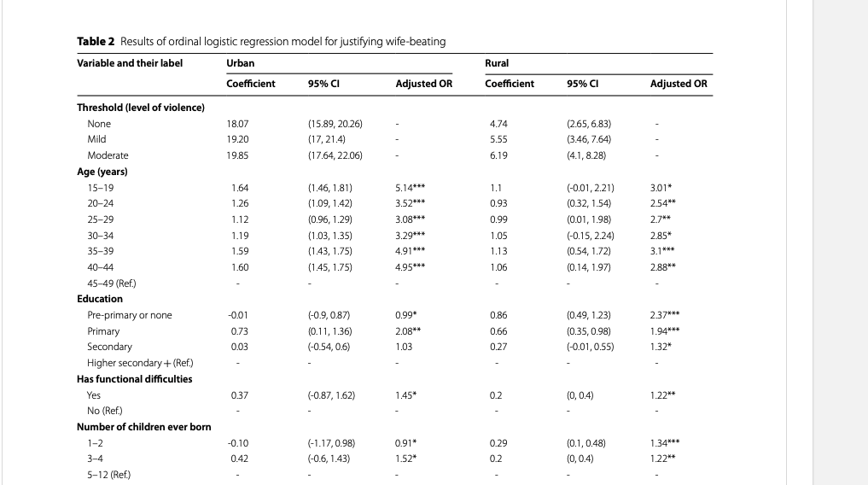

Slide 10
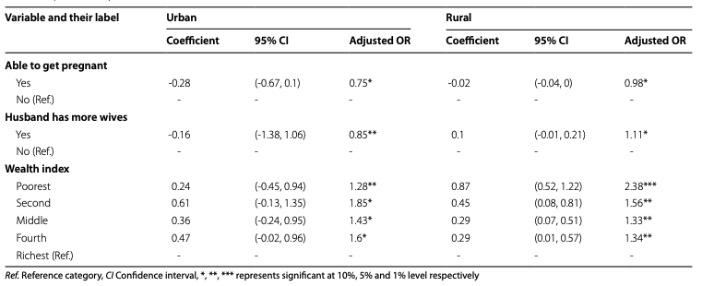

Slide 11
Hypothesis Testing
A hypothesis is a statement about one or more populations
Hypothesis is concerned about population (not sample)
Two types of hypothesis:
Null hypothesis
Alternative hypothesis
Climate change and human health in the UK
Null hypothesis: There is no impact of climate change on human health in the UK
Alt Hypo: there is impact of climate change on human health in the UK
Notes:
Weight and height among school children
Null hypthe= the weight and height of school children are not equal
Alt= the wight and hiegh of school are equal

Slide 12
Null hypothesis:
Null hypothesis is the hypothesis of no difference or equality
We test the null hypothesis, not the alternative hypothesis

Slide 13
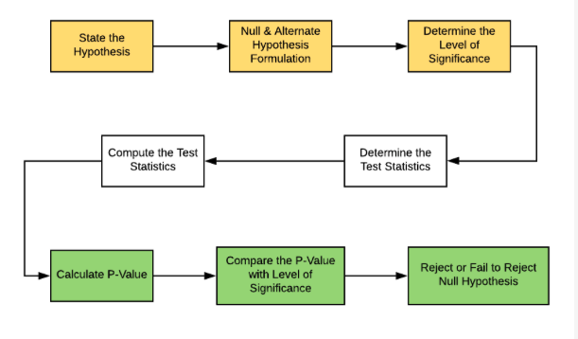
Hypothesis Testing Steps

Slide 14
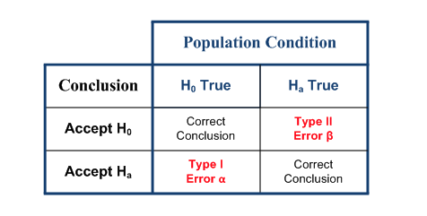
Type 1 and 2 error

Slide 15
Mathematics Test
This assignment counts for 25% of the total module mark.
Instructions
The test should be submitted any time in Week 7.
This is an online test, written and submitted directly on the VLE. No other submission formats will be accepted.
You can type-in your answer or upload a file with your answer e.g. word document.
You will have 1 hour to complete the test in one sitting. So only start the test when you are sure you can complete it in one sitting. No reattempt will be allowed.
During the test you are only allowed to use a calculator, no other equipment is allowed.
Practice for this test is available as the questions provided for the Data and Probability Activities in units 1 to 7.
Ensure you review the notes in units 1 to 7 prior to taking the test.
Please note that you are not required to produce any R code during this test.

Slide 16
The following dataset refers to the number of children in each of 24 surveyed families.
Draw a frequency distribution table and calculate relative frequency and percentage.
0 | 1 | 2 | 0 | 3 | 0 | 1 | 1 | 0 | 2
3 | 2 | 1 | 1 | 2 | 4 | 3 | 4 | 2 | 2
2 | 1 | 0 | 3

Slide 17
No of children | Frequency | Relative frequency | Percentage
0 | 5 | 0.21 | 21
1 | 6 | 0.25 | 25
2 | 7 | 0.29 | 29
3 | 4 | 0.17 | 17
4 | 2 | 0.08 | 8
Total | 24 | 1 | 100

Slide 18
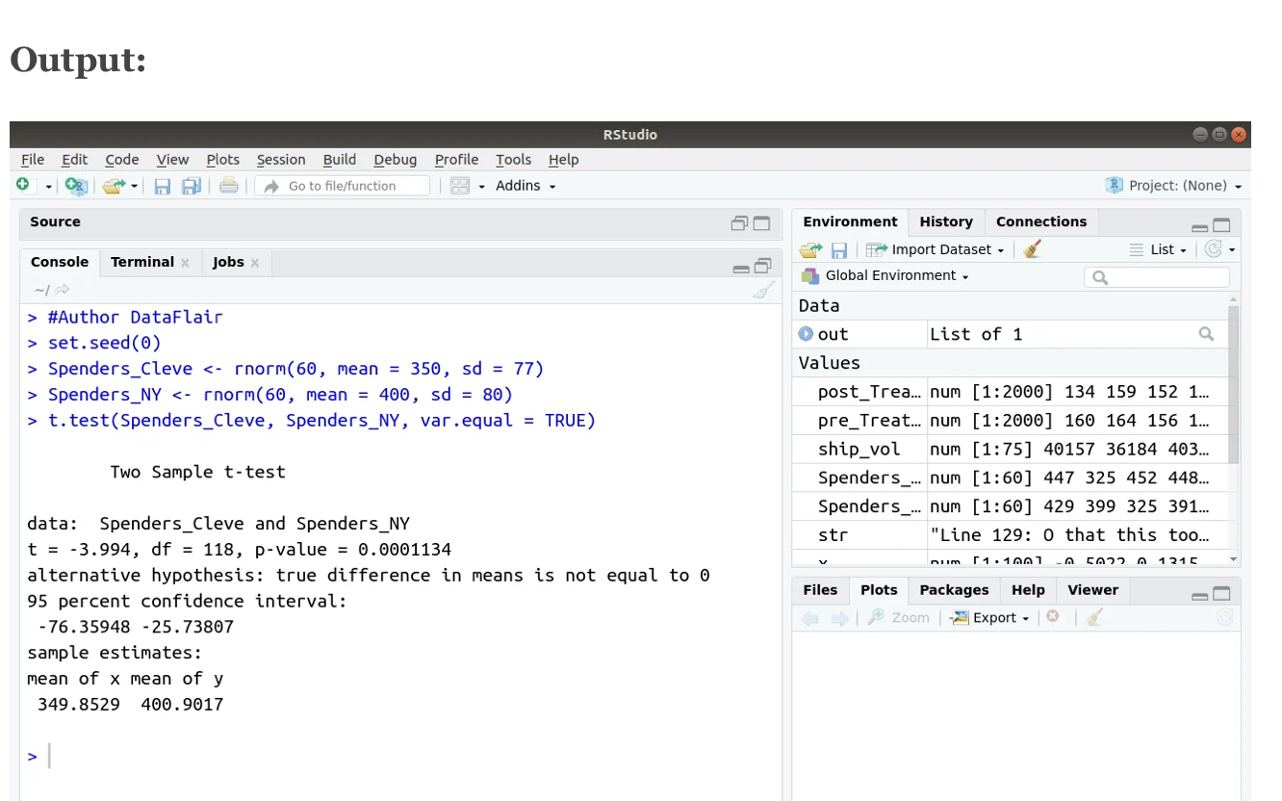
Notes:
Here two sample t-test has been performed.
The t-test value is -3.994 with a p-value 0.00 which is lower than 0.01 so we can conclude that there is difference between the groups and the test statistics is significant
The 95% CI shows that it does not include 1, so it is significant
The mean differences are shown for both groups and there is a difference in mean for both groups are observed.

Slide 19
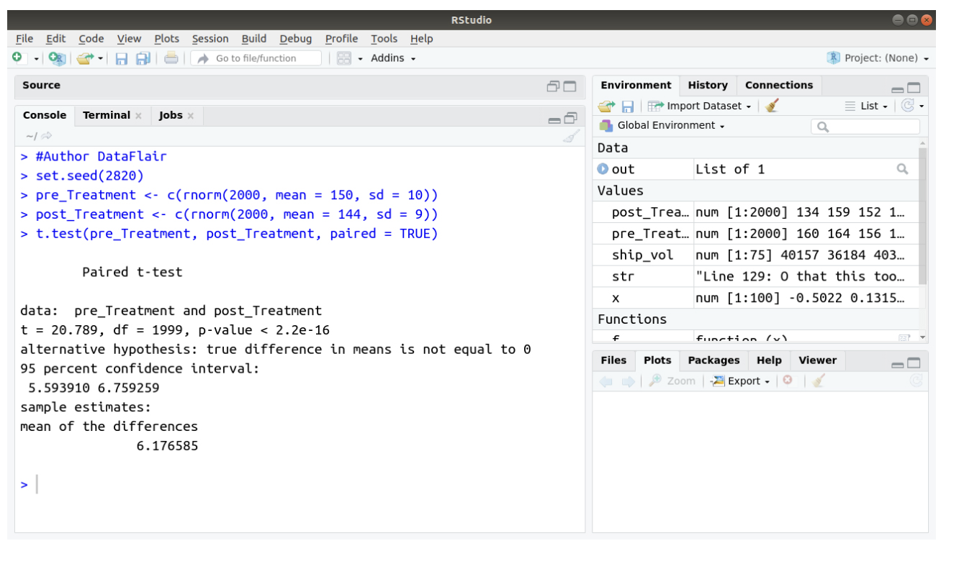
Notes:
Here, paired t-test was performed and it is useful when there is before and after scenario.
The T-test value is 20.789 with a p-value <2.2e-16 which is higher than 0.05 so we can say that test is insignificant
95 % CI does not contain 1, it is significant
Mean differences are shown for two is 6.17

Slide 20
Discussion?
Q&A?

